Slide 1
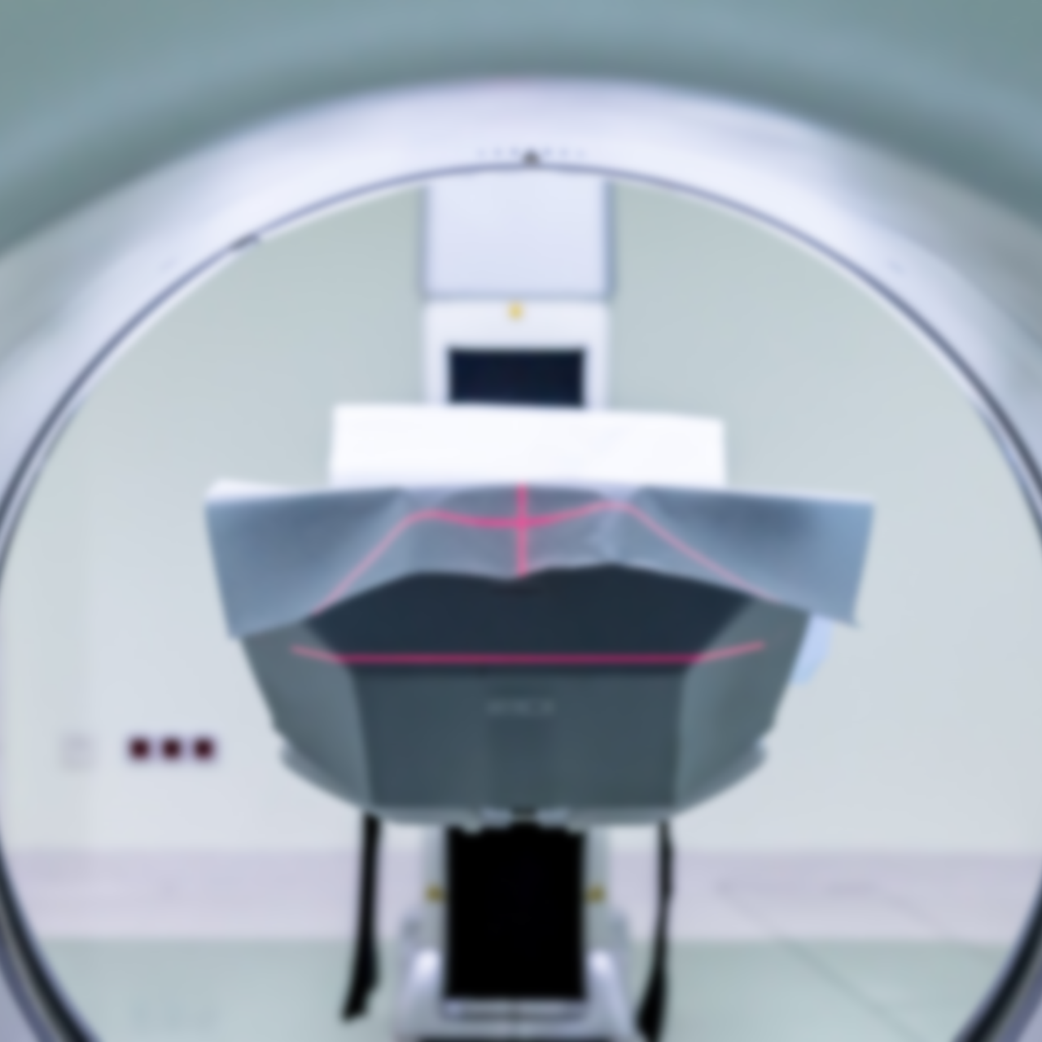
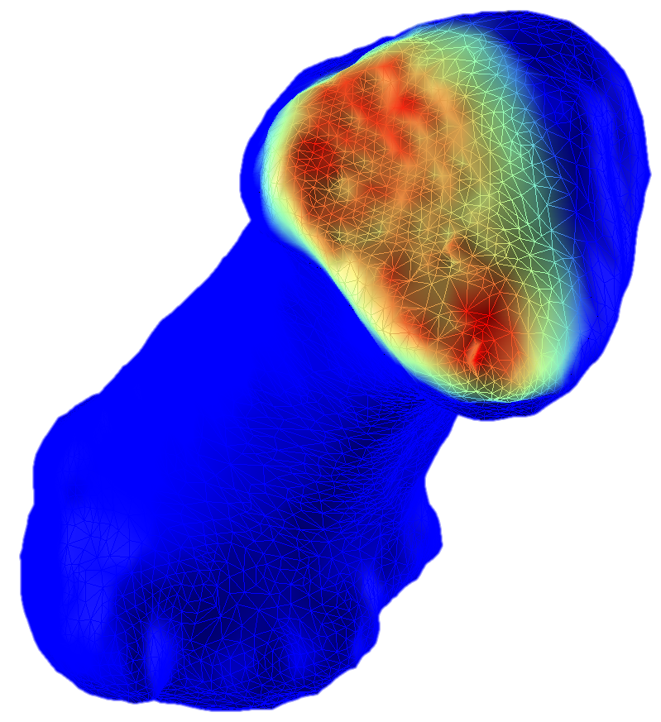
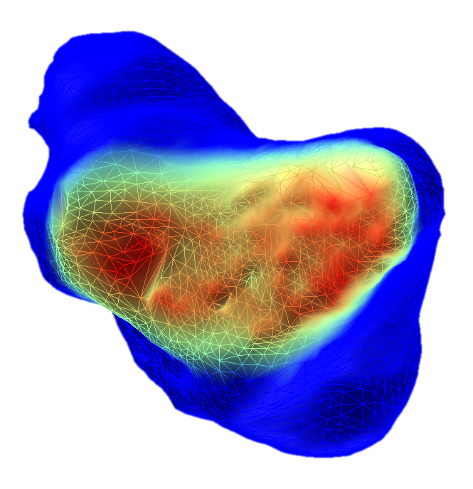
Evaluating Intra-Articular Joint Pressure using Medical Imaging Technology

Slide 2
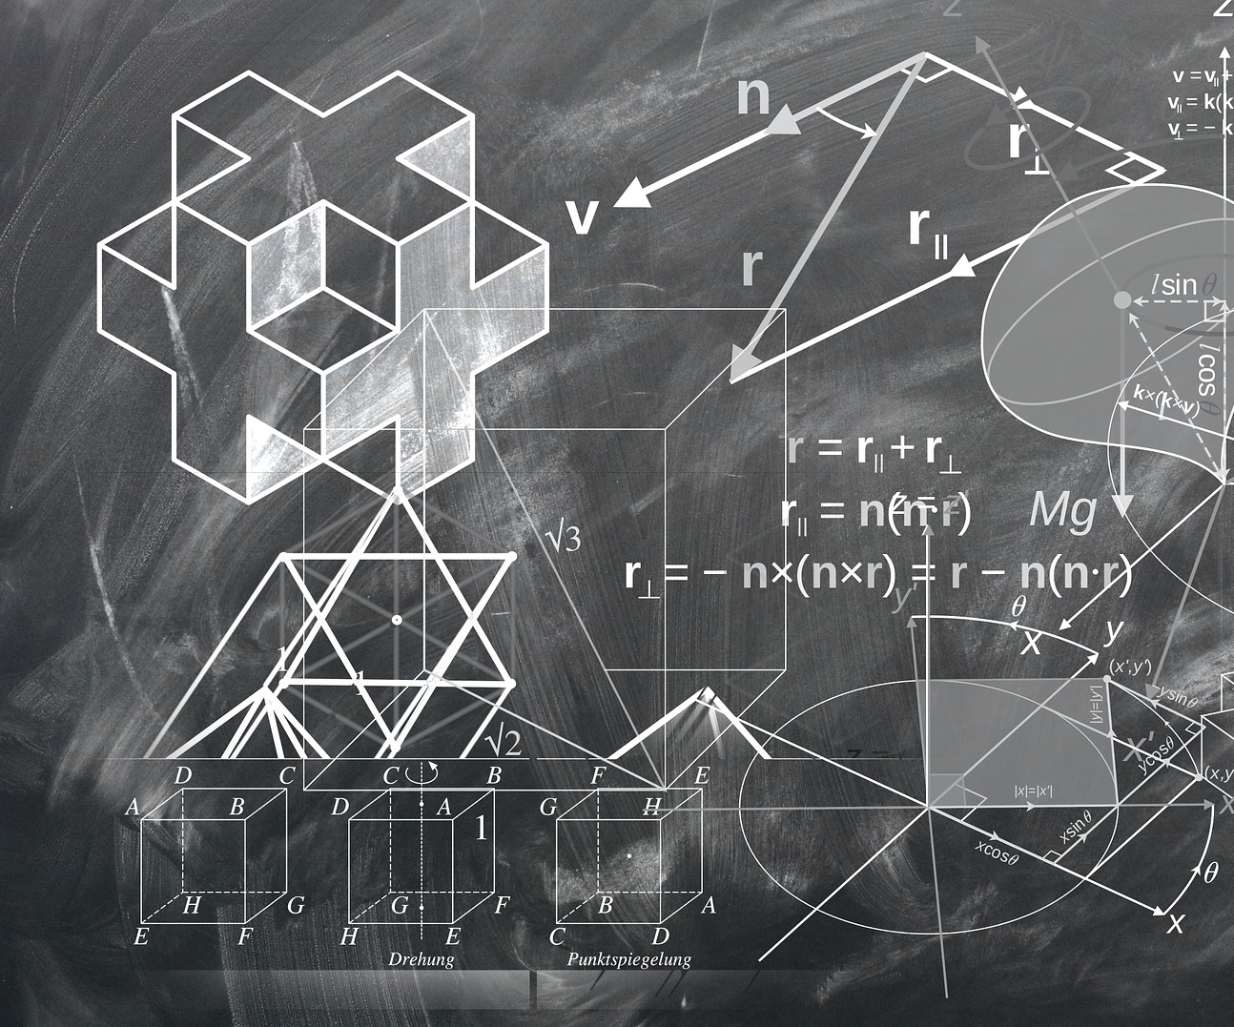
Development of a 3D Transformations Toolbox for Motion Capture and 3D Image Processing

Slide 3
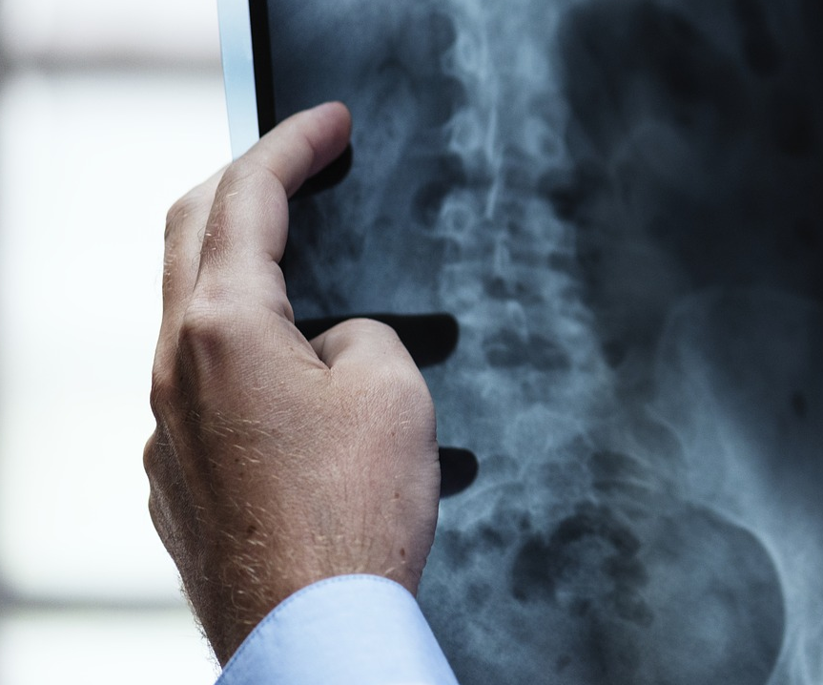
Assessing Human Joints Mobility using Static Medical Imaging Technology

Slide 4
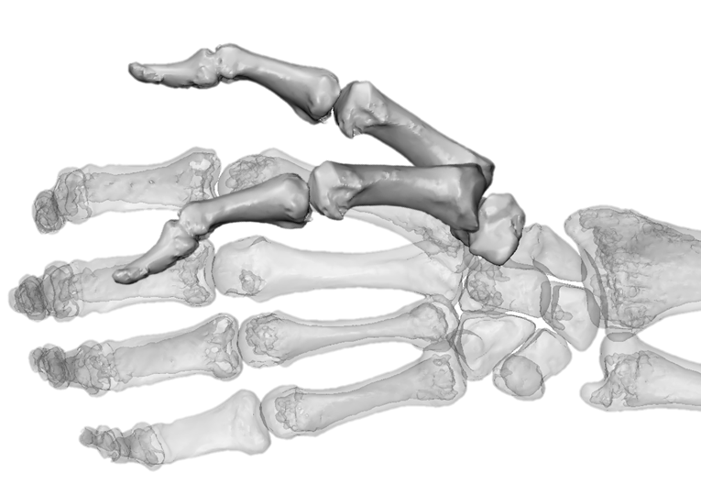
Measuring the Accuracy of Dynamic Medical Imaging to Assess Thumb Motion

Slide 5
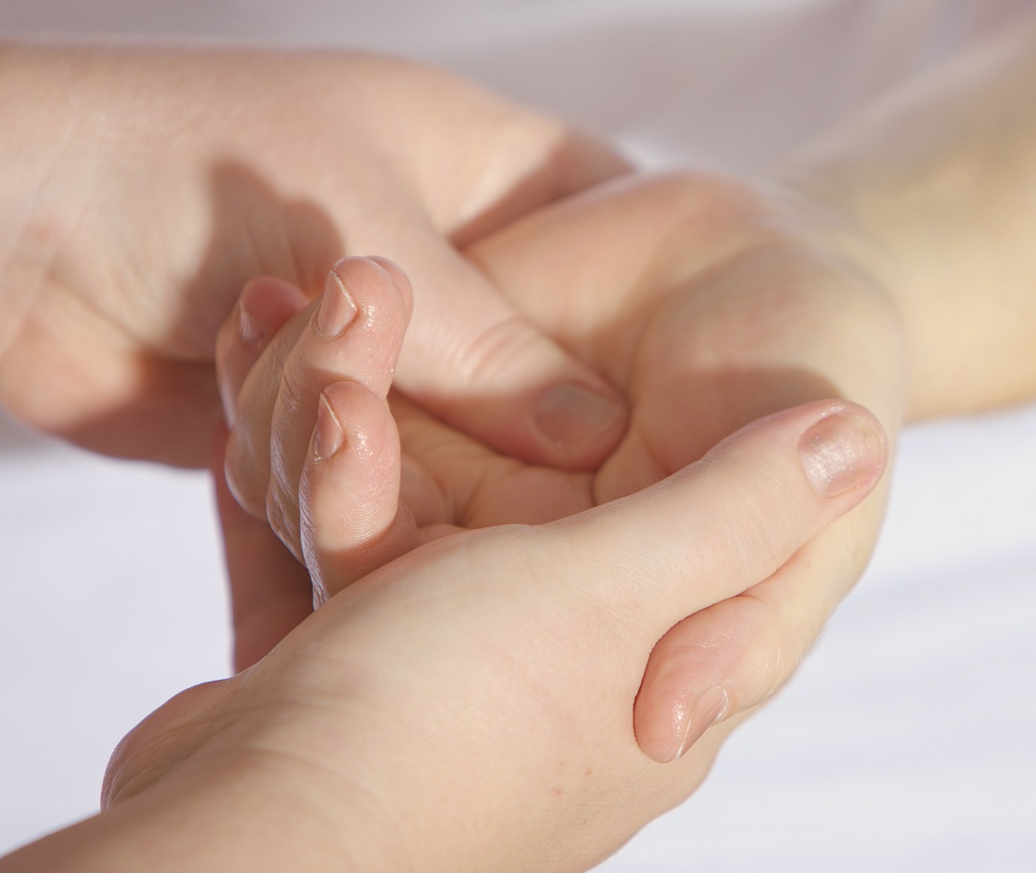
Assessing the Morphological Impact of Thumb Osteoarthritis

Slide 6
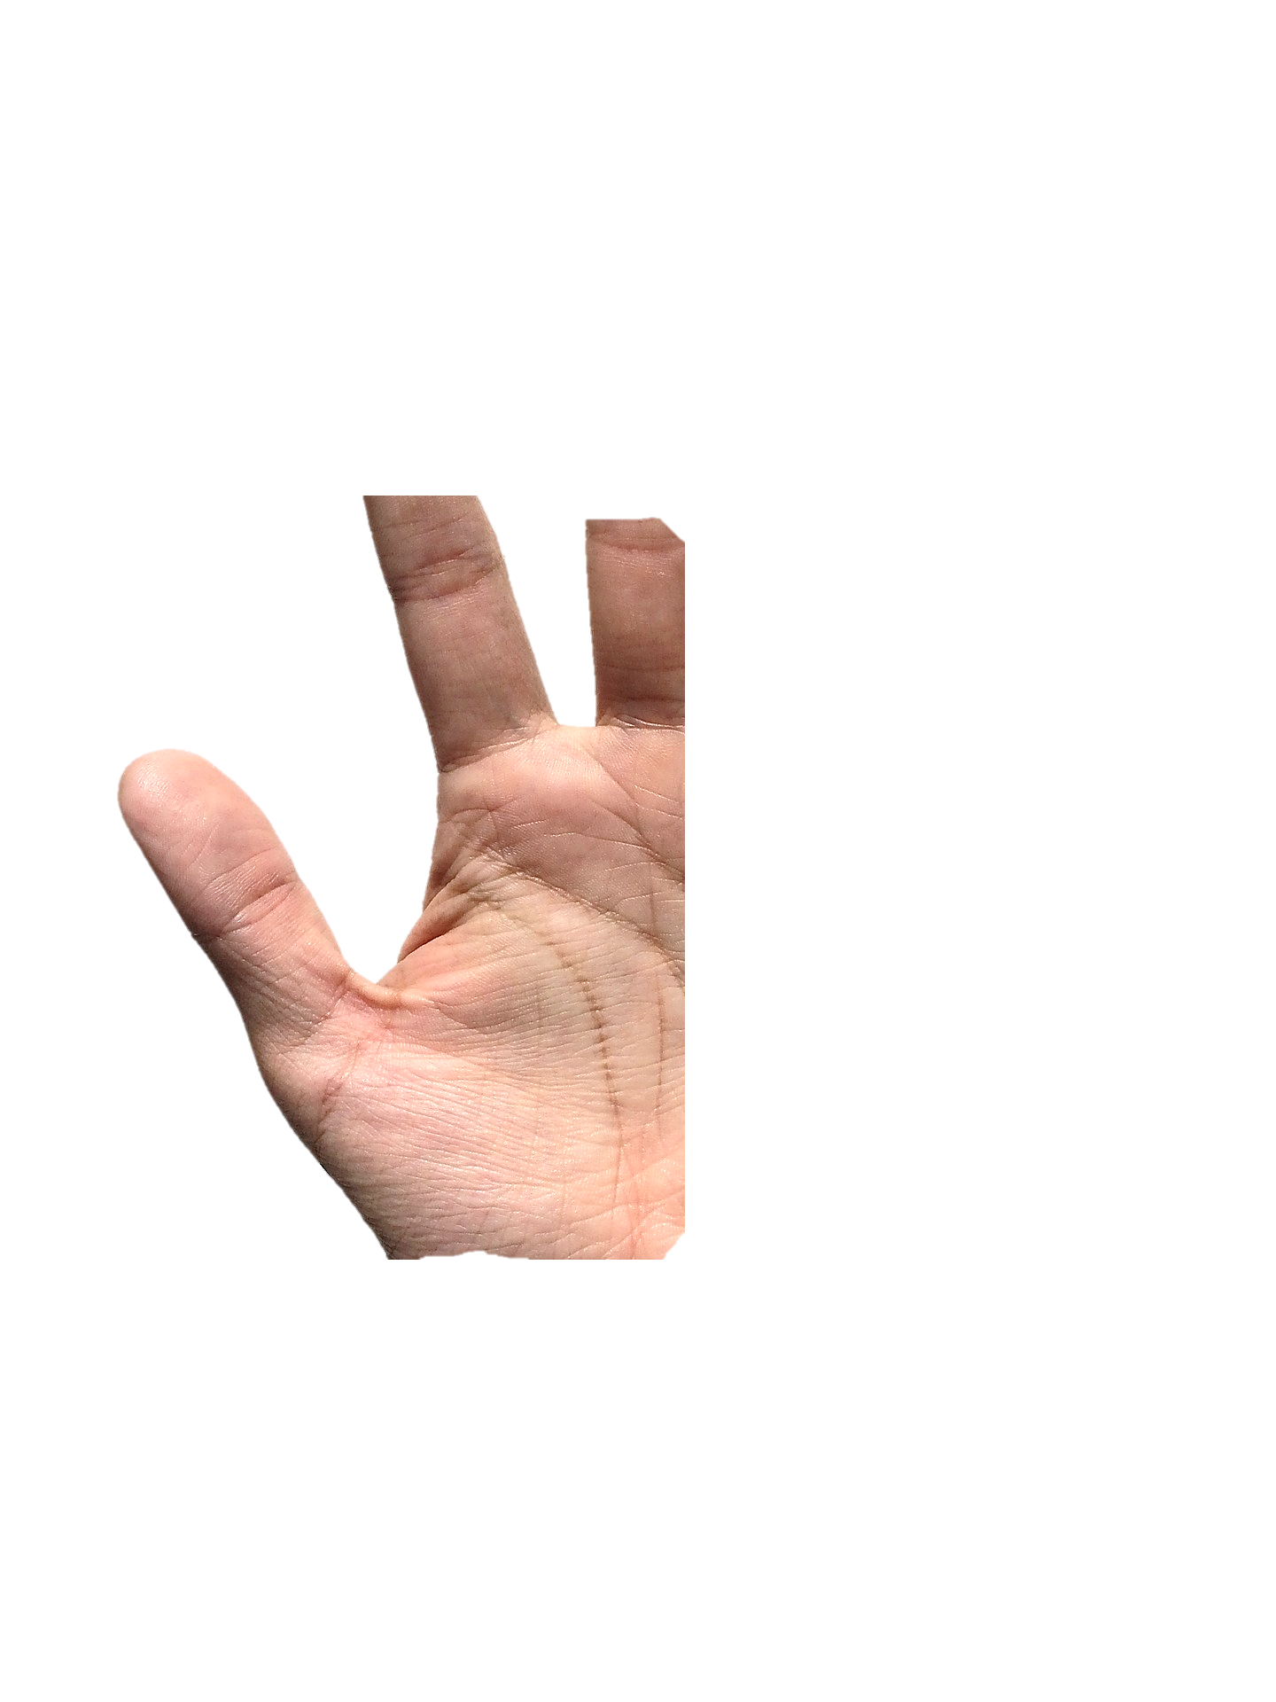
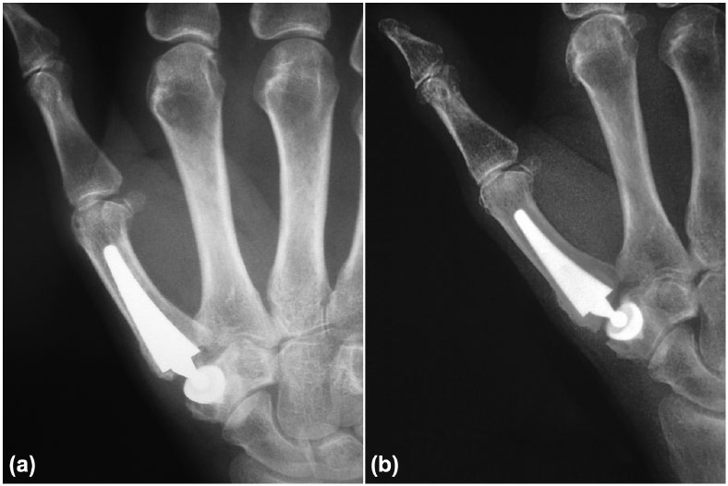
Measuring the Impact of Total Thumb Replacement on Hand Mobility

Slide 7

Development of a Signal Processing Toolbox for Filtering, Interpolating and Analysing Time Series

Slide 8
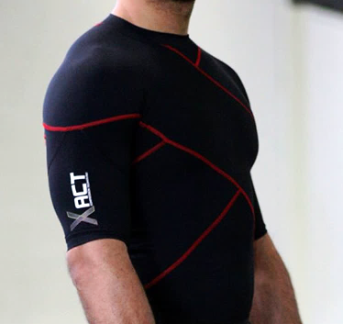
Measuring the Impact of Compression Garments on Shoulder Mobility and Stability

Slide 9

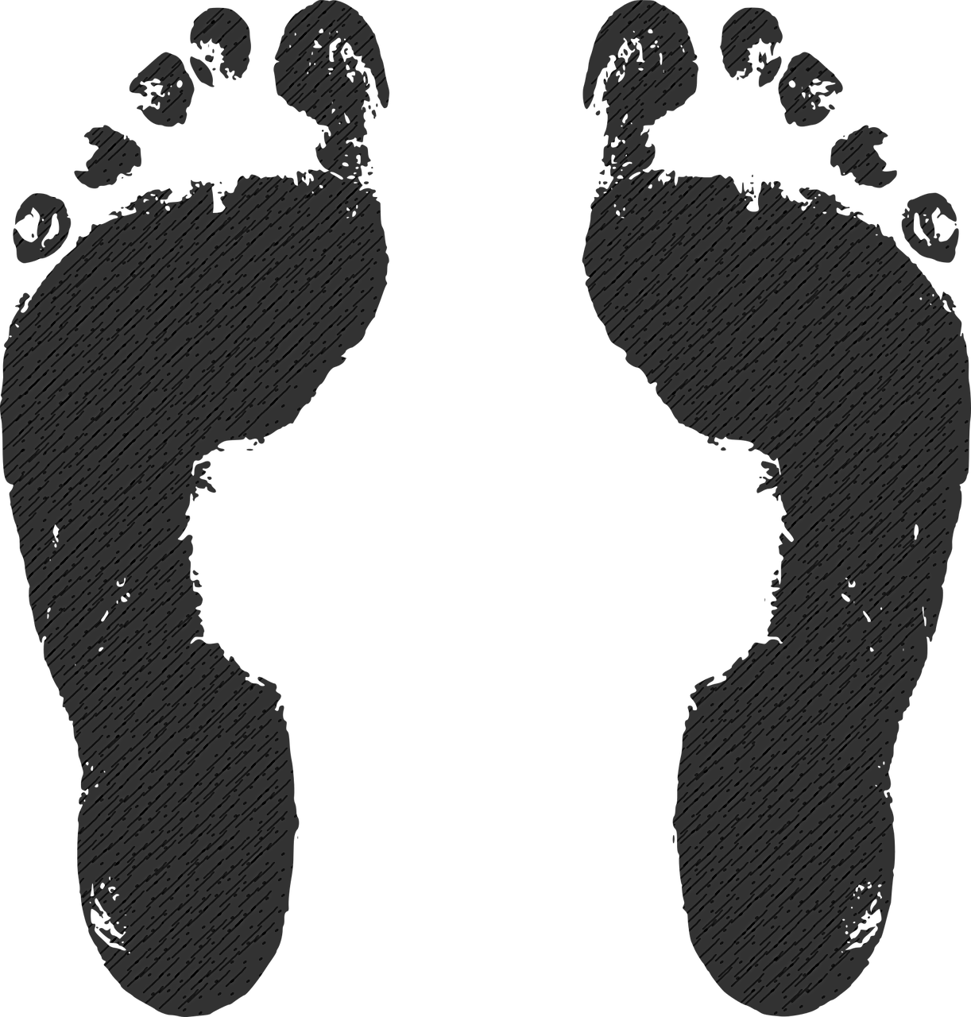
Comparison Between Foot Pressure Mapping Technologies

Slide 10
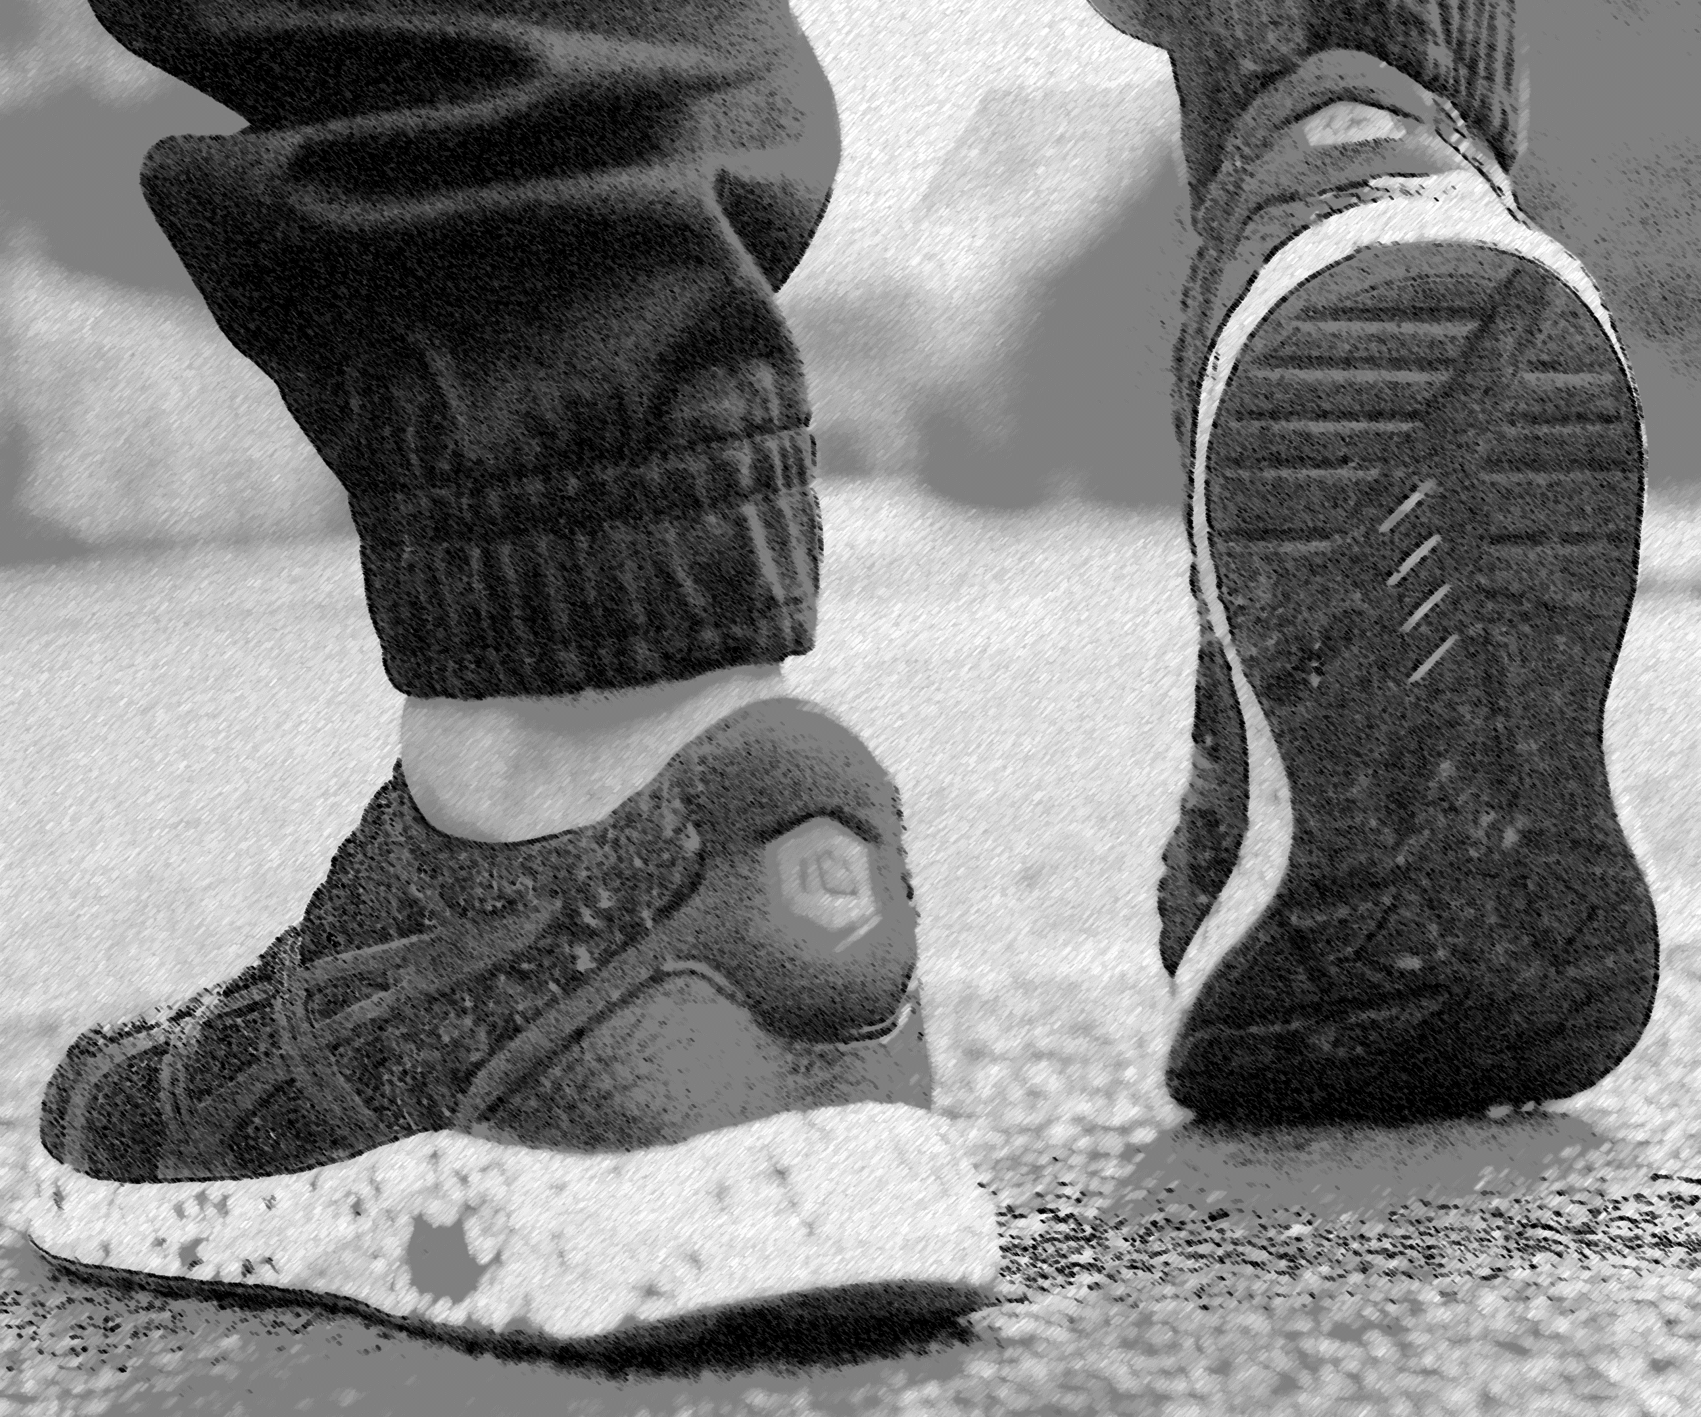
Measuring the Impact of Custom Orthotics on Legs and Feet Biomechanics

Slide 11
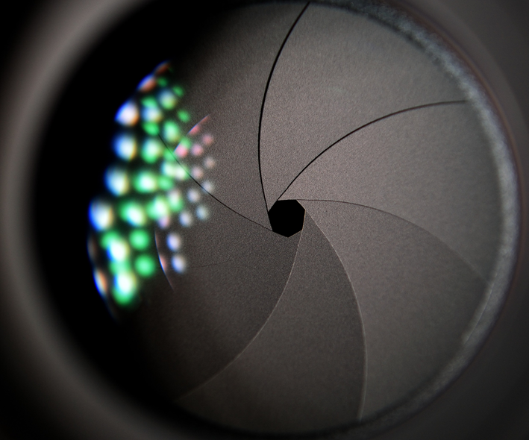
SOFT TISSUES PROPERTIES
Academic
Publication
Motion Capture Enhancement using Sequence Modeling and Recurrent Neural Network
Developed a protocol to assess soft tissues properties using medical imaging
2018

Slide 12
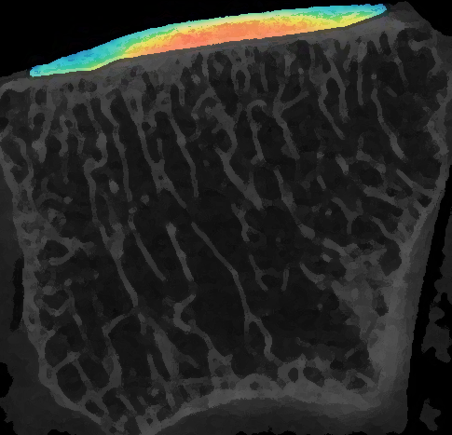
SOFT TISSUES PROPERTIES
Academic
Publication
Assessing Soft Tissues Properties using Contrast Enhanced Medical Imaging Technology
Developed a protocol to assess soft tissues properties using medical imaging
2018

Slide 13
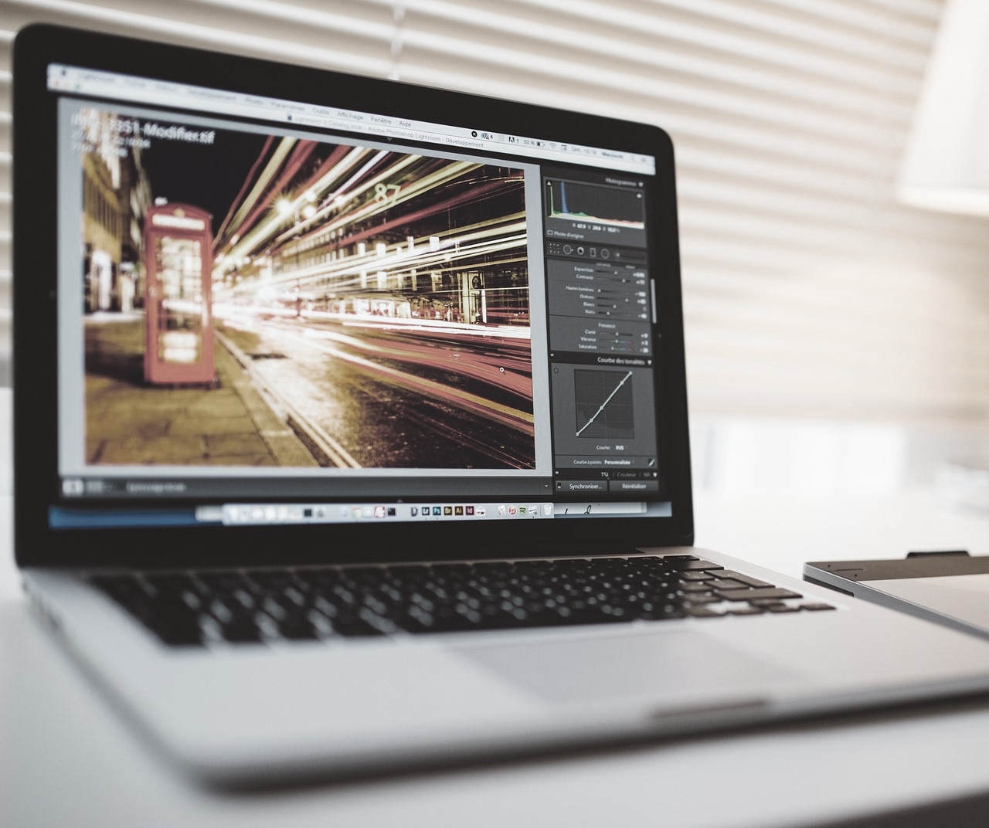
Development of an Image Annotation Tool for Algorithm Performance Assessment

Slide 14
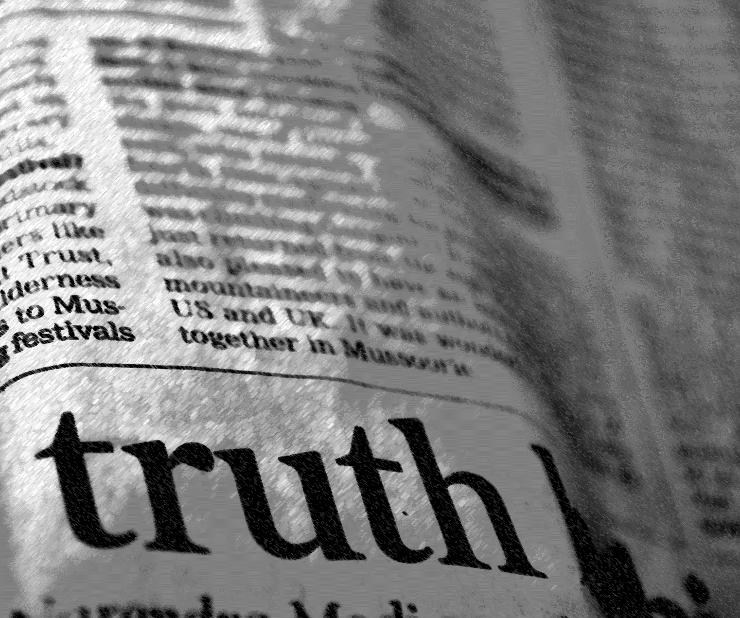
Real vs. Fake News Classification using
Natural Language Processing

Slide 15

Predicting Ocean Water Temperature using
Linear Regression

Slide 16

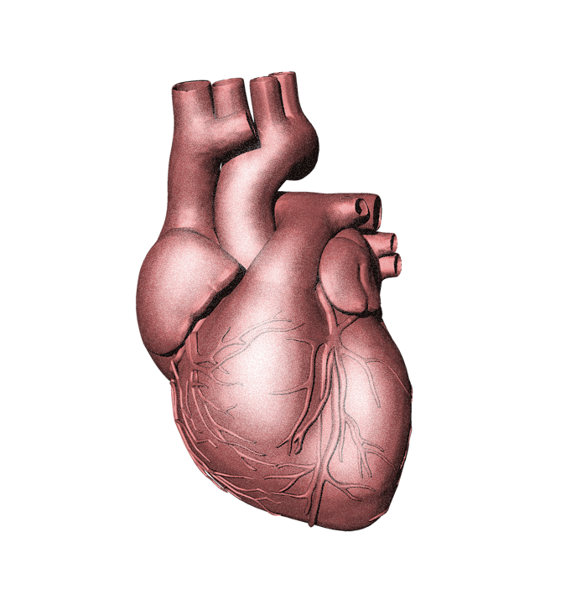
Predicting Risk of Coronary Heart Disease using Support Vector Machine (unbalanced dataset)

Slide 17

Detecting Fraudulent Credit Card Transactions using Logistic Regression (unbalanced dataset)

Slide 18
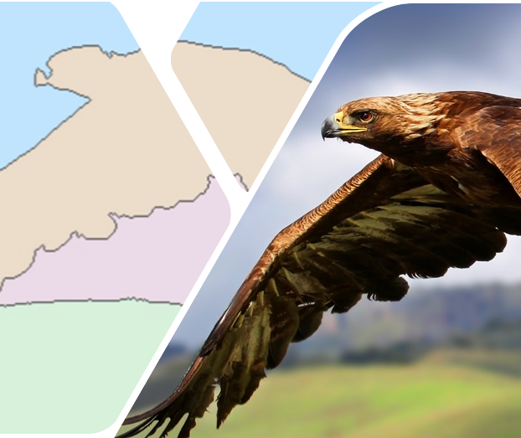
Semi-Automated Image Segmentation using the Watershed Algorithm

Slide 19
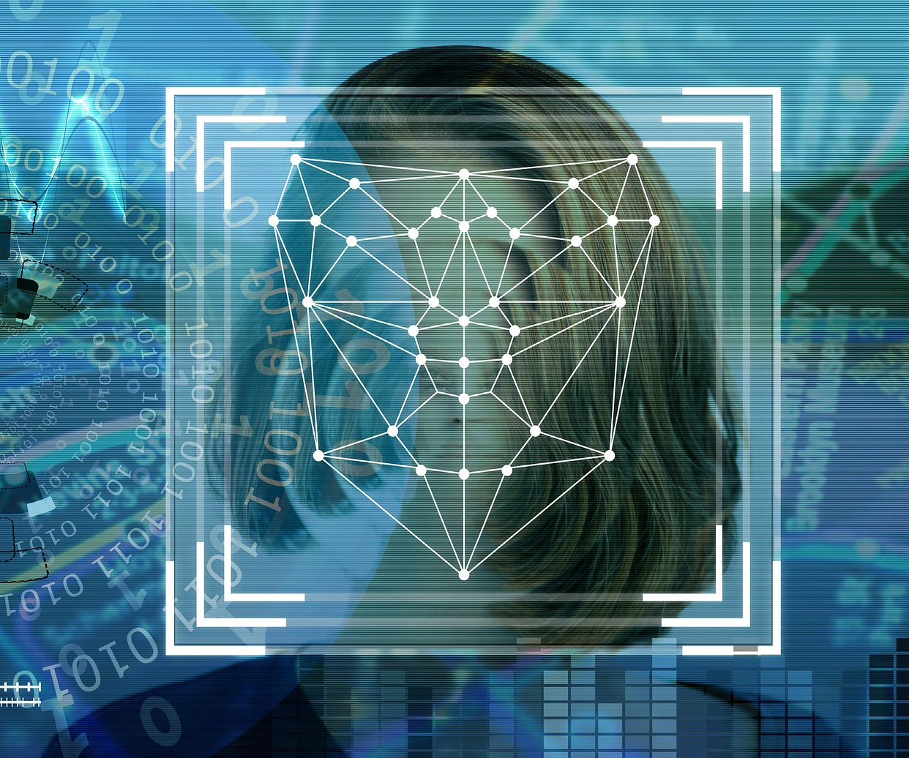
Face Detection using Haar Cascades and
Tracking APIs

Slide 20
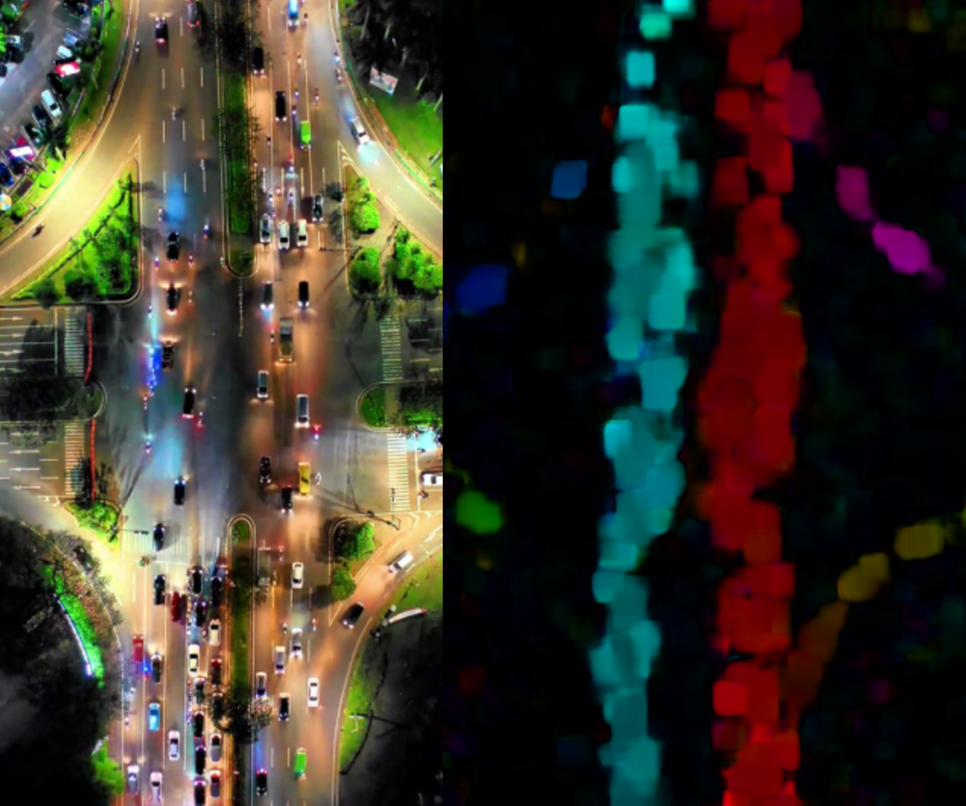
Automated Motion Detection using Dense Optical Flow Mapping

Slide 21
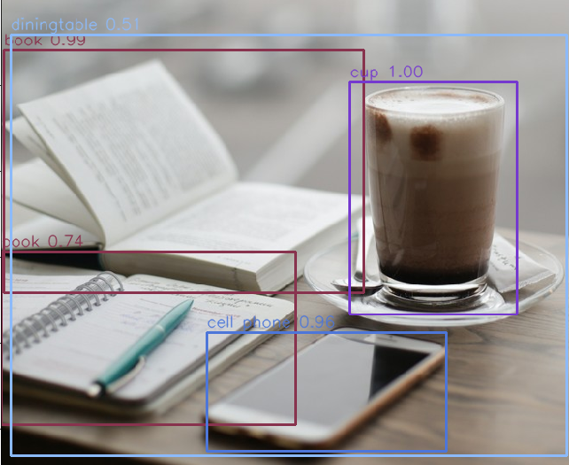
Implementation of the Pre-Trained YOLO Model for Automated Object Detection

Slide 22
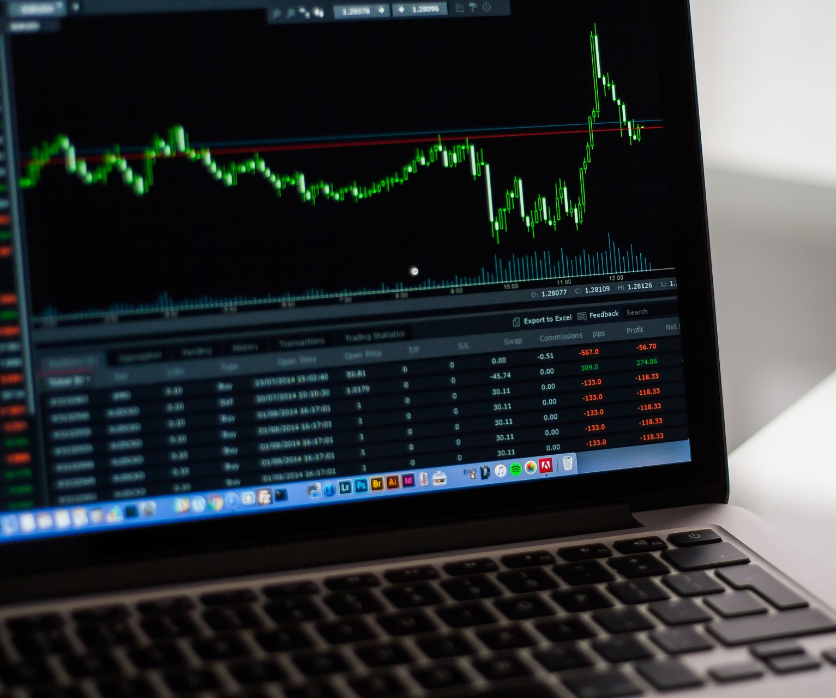
Stock Market Forecasting using Deep Recurrent Neural Network

Slide 23
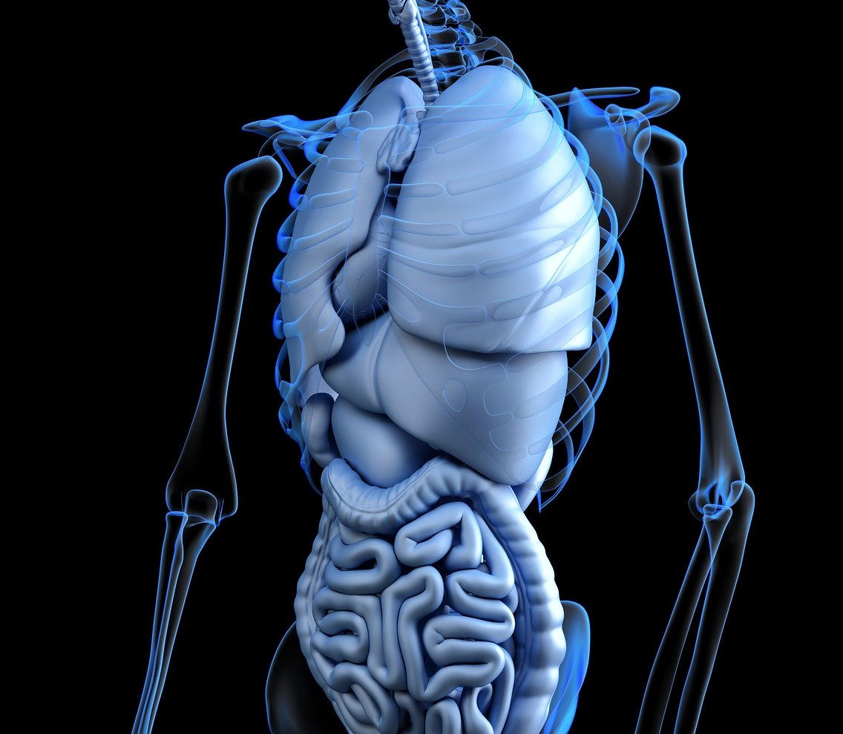
Multi-Organ Image Segmentation using Multi-Scale Pyramid 3D Fully Convolutional Network

Slide 24
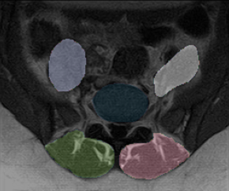
Automated Segmentation of Spinal Muscles From Upright Open MRI Using a Multiscale Pyramid 2D Convolutional Neural Network

Slide 25

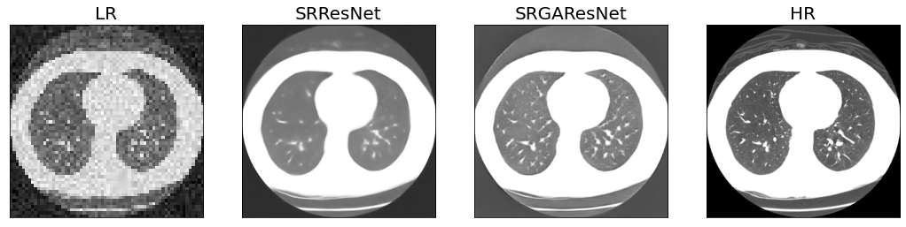
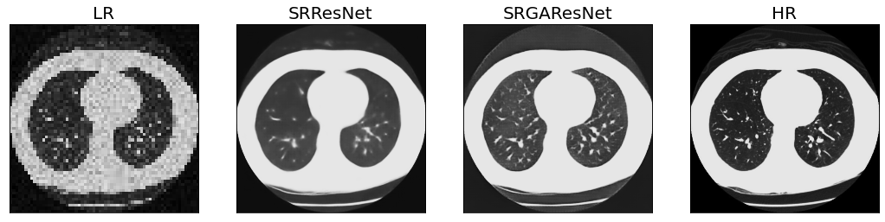
Medical Imaging Resolution Enhancement using Super Resolution Neural Network

Slide 26
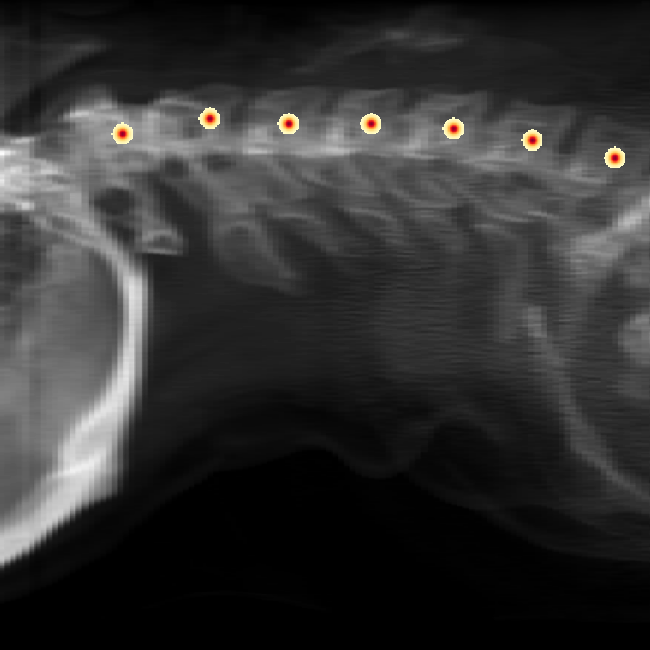
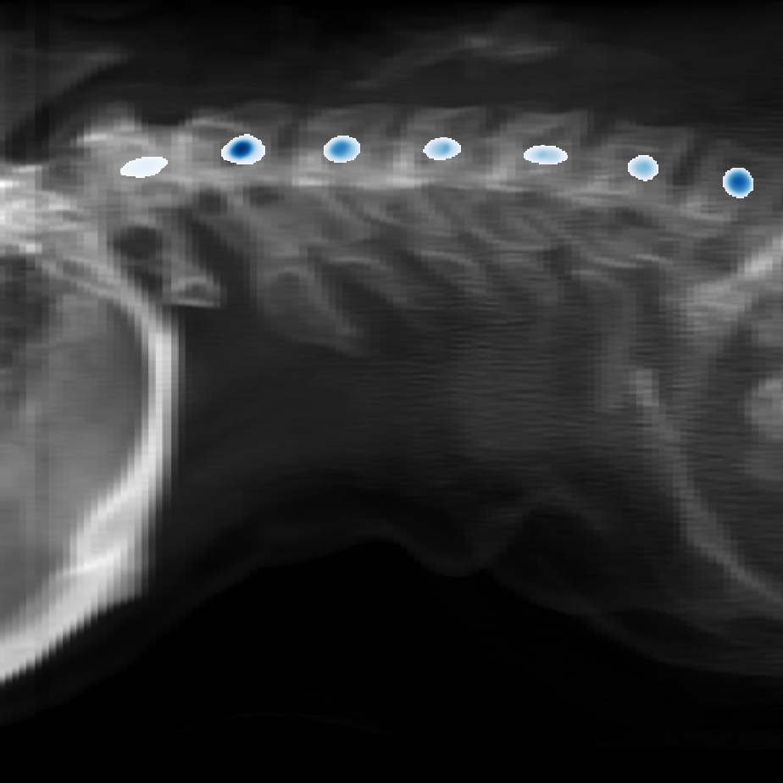
Ground Truth
Predicted
Automated Landmark Detection using Convolutional Neural Network

Slide 27


Running the Llama 2 Large Language Model Locally in Jupyter Notebook

